Slide 1
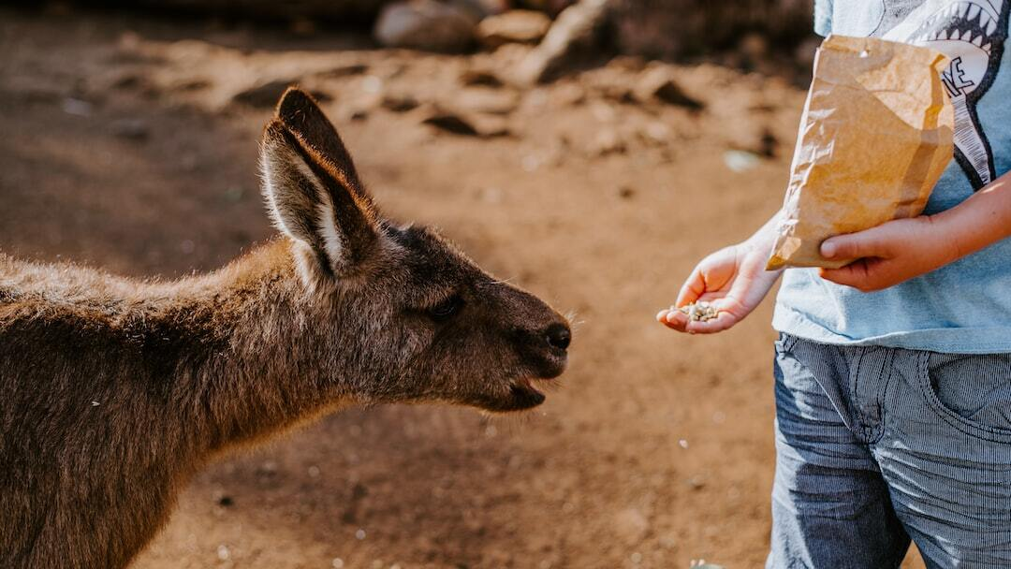
Animal Explorer for Kids
Overview: An interactive tool to help kids learn about different animals through image classification using a fine-tuned MobileNetV2 model, with additional descriptions generated using the Google PaLM API.
  Purpose: To provide an engaging and educational experience for children, enabling them to learn about various animals through images and AI-generated descriptions.
  Objectives: 1. Classify images of animals using a trained model. 2. Generate educational content using AI. 3. Provide an intuitive and interactive GUI for kids.

Slide 2
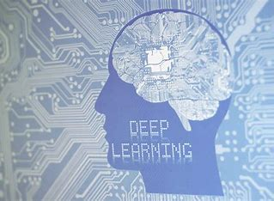
Animal Explorer for Kids
High-level Architecture: The system consists of several key components including data preparation, model training, and prediction modules integrated into a user-friendly interface.
  Components Description: 1. **Data Preparation:** Handles data preprocessing and augmentation. 2. **Model Training:** Uses MobileNetV2 for image classification. 3. **Prediction Module:** Provides classification results and generates additional information using the Google PaLM API.

Slide 3
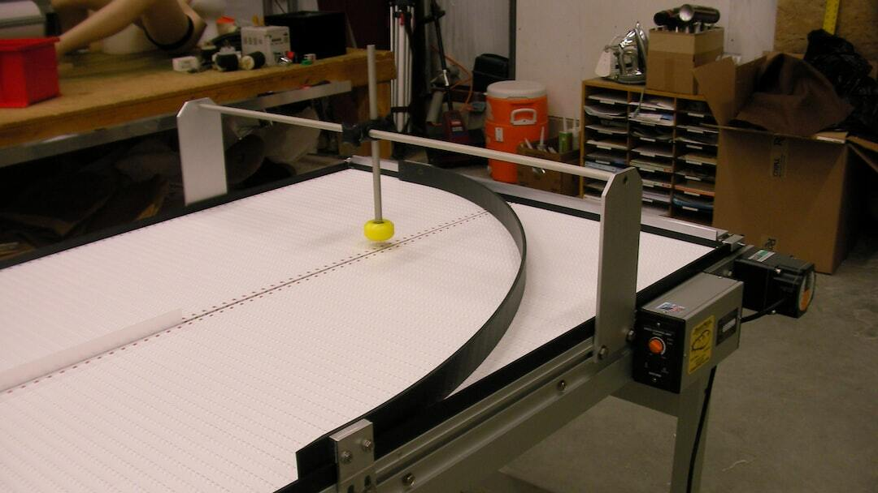
Animal Explorer for Kids
Data Sources and Preprocessing: Images are sourced from various datasets and preprocessed to ensure consistency and quality. Steps include resizing, normalization, and data augmentation.
  Training and Validation Data Setup: The dataset is split into training and validation sets. Each category is limited to a certain number of images to balance the dataset and improve model performance.

Slide 4
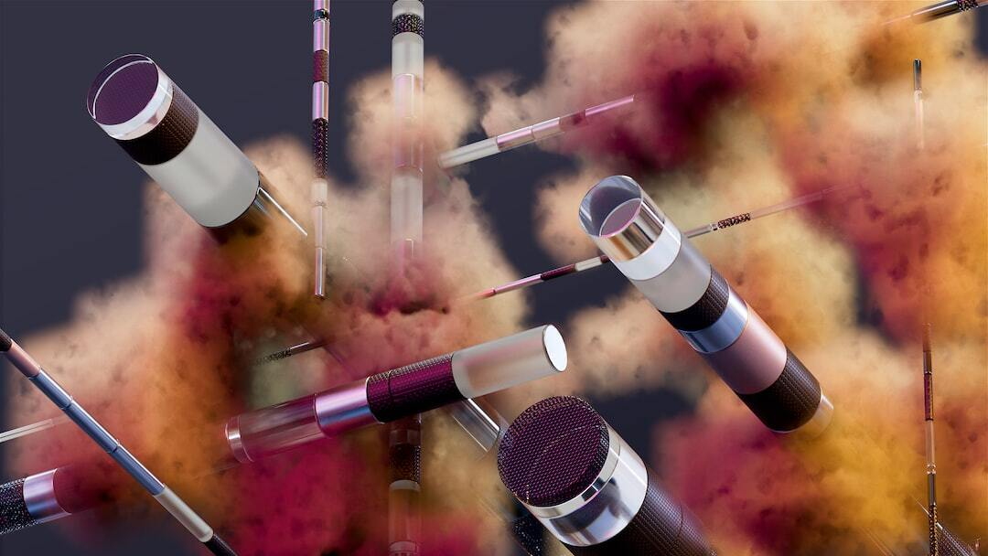
Animal Explorer for Kids
Model Selection: MobileNetV2 is chosen for its efficiency and performance in image classification tasks. The model is fine-tuned on our dataset to recognize various animals.
  Training Process and Results: The model is trained using augmented data to enhance generalization. Early stopping and model checkpoints are utilized to ensure optimal performance.

Slide 5
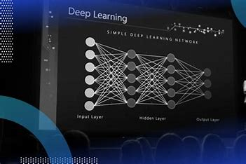
Animal Explorer for Kids
Image Classification: The trained MobileNetV2 model processes the input image to predict the animal category. The classification result is displayed to the user.
  Google PaLM API Integration: The classification result is used to generate additional educational content using the Google PaLM API, providing context and information about the identified animal.

Slide 6
Animal Explorer for Kids
Interactive GUI: The user interface allows children to upload images of animals, view classification results, and read additional information generated by the AI.
  User Experience: Designed to be intuitive and engaging, the GUI helps kids interact with the tool effortlessly. The interface provides clear instructions and displays results in a user-friendly manner.
  Screenshots: Below are screenshots of the user interface in action: 1. Initial interface with upload option. 2. Classification result displaying 'elephant'. 3. Classification result displaying 'cat'.

Slide 7

Animal Explorer for Kids
Summary of Achievements: The Animal Explorer for Kids project successfully combines image classification and AI-generated content to provide an engaging educational tool for children. The system's intuitive interface and accurate predictions enhance the learning experience.
  Future Improvements: 1. Expanding the dataset to include more animal categories. 2. Enhancing the model's accuracy with additional training data. 3. Adding more interactive features to the GUI to improve user engagement.
  Next Steps: Continued development and user testing to refine the tool and expand its educational capabilities.

Slide 8
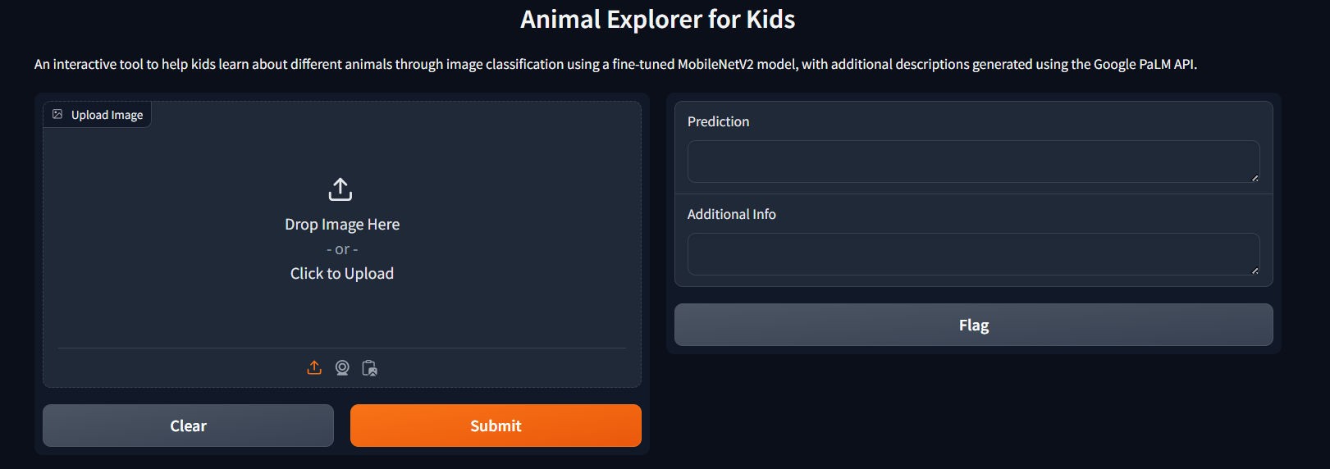
Output

Slide 9
